Slide 1
Process Models
There are different Types of Process Models:
Software Development Life Cycle
waterfall model
Incremental Process models
RAD Model
Unified Process Model
Evolutionary Process models
i. Prototype Model
ii. Spiral Model
iii. Concurrent Development Model
iv. V-Model
v. Agile Model

Slide 2
What is a software process model?
A software process model is an abstraction of the software development process. The models specify the stages and order of a process. So, please think of this as a representation of the order of activities of the process and the sequence in which they are performed.
A model will define the following:
The tasks to be performed.
The input and output of each task.
The pre-conditions and post-conditions for each task.
The flow and sequence of each task.

Slide 3
Software Development Life Cycle (SDLC)
Requirements Gathering and Analysis
Planning
Design
Implementation (Coding)
Testing
Deployment
Maintenance

Slide 4
Requirements Analysis
Planning
Maintenance
Deployment
Design
Implementation
Testing

Slide 5
1. Requirements gathering and analysis:This phase involves gathering information about the software requirements from stakeholders, such as customers, end-users, and business analysts.
2. Planning: this phase, a Senior QA manager will determine effort and cost estimates for the project and will prepare and finalize the Test Plan
3. Design: In this phase, the software design is created, which includes the overall architecture of the software, data structures, and interfaces. It has two steps:
High-level design (HLD): It gives the architecture of software products.
Low-level design (LLD): It describes how every feature and component of the product should work.
4. Implementation or coding: The design is then implemented in code, usually in several iterations, and this phase is also called as Development.
things you need to know about this phase:
This is the longest phase in the SDLC model.
This phase consists of Front end + Middleware + Back-end.
In front-end: Coding development is done even SEO settings are done.
In Middleware: They connect both the front end and back end.
In the back-end: A database is created.

Slide 6
5. Testing: The software is thoroughly tested to ensure that it meets the requirements and works correctly.
6. Deployment: After successful testing, The software is deployed to a production environment and made available to end-users.
7. Maintenance: This phase includes ongoing support, bug fixes, and updates to the software.
There are different methodologies that organizations can use to implement the SDLC, such as Waterfall, Agile, Scrum, V-Model , and DevOps

Slide 7
waterfall model
The waterfall is also called the Linear Sequential model, classic life cycle, or Traditional process model.
In this model each phase is fully completed before the beginning of the next phase.
This model is used for small projects.
In this model feedback is taken after each phase to ensure the project is on the right path.
Testing part starts only after the development is complete.

Slide 8
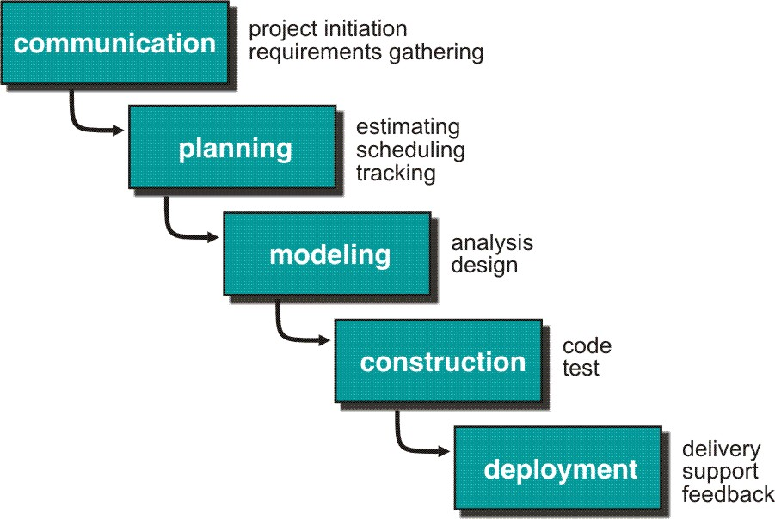

Slide 9
5 Phases of the Waterfall Model:
1. Communication
2. Planning
3. Modeling
4. Construction
5. Deployment

Slide 10
1. Communication
In the communication phase, the major task performed is requirement gathering which helps in finding out the exact needs of the customer. Once all the needs of the customer are gathered the next step is planning.
2. Planning
In planning major activities like planning for schedule, keeping track on the processes, and the estimation related to the project are done. Planning is even used to find the types of risks involved throughout the projects. Planning describes how technical tasks are going to take place and what resources are needed and how to use them.

Slide 11
3. Modeling
This is one of the important phases of the architecture of the system is designed in this phase. An analysis is carried out and depending on the analysis a software model is designed. Different models for developing software are created depending on the requirements gathered in the first phase and the planning done in the second phase.
4. Construction
The actual coding of the software is done in this phase. This coding is done based on the model designed in the modeling phase. So, in this phase software is developed and tested.
5. Deployment
In this last phase, the product is rolled out or delivered & installed at the customer’s end and support is given if required. Feedback is taken from the customer to ensure the quality of the product.

Slide 12
Advantages of the Waterfall Model
1. The waterfall model is simple and easy to understand, implement, and use.
2. All the requirements are known at the beginning of the project hence it is easy to manage.
Disadvantages of Waterfall Model
1. This model is not good for complex and object-oriented projects.
2. It is a poor model for long projects.

Slide 13
Incremental Process Model
1. The incremental model in software engineering is one such which combines the elements of the waterfall model iteratively.
2. It delivers a series of releases called increments that provide progressively more functionality for the client as each increment is delivered.
3. The first increment in this model is generally a core product.
4. Each increment builds the product and submits it to the customer for any suggested modifications.
5. the next increment requirements in the previous increment.
6. this process is repeated until the product is finished.

Slide 14
Iterative Process Like:
Developer ------------------→ Customer
Customer ------------------→ Developer
Developer ------------------→ Customer
5 Phases of the Incremental Model:
1. Communication
2. Planning
3. Modeling
4. Construction
5. Deployment

Slide 15
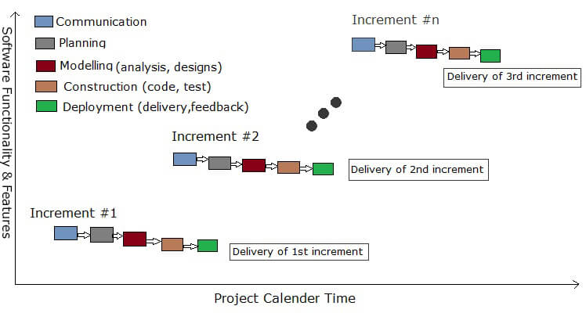

Slide 16
1. Communication
In the communication phase, the major task performed is requirement gathering which helps in finding out the exact need of the customer. Once all the needs of the customer are gathered the next step is planning.
2. Planning
In planning major activities like planning for schedule, keeping tracks on the processes and the estimation related to the project are done. Planning is even used to find the types of risks involved throughout the projects. Planning describes how technical tasks are going to take place and what resources are needed and how to use them.

Slide 17
3. Modeling
This is one of the important phases of the architecture of the system is designed in this phase. An analysis is carried out and depending on the analysis a software model is designed. Different models for developing software are created depending on the requirements gathered in the first phase and the planning done in the second phase.
4. Construction
The actual coding of the software is done in this phase. This coding is done based on the model designed in the modeling phase. So, in this phase software is developed and tested.
5. Deployment
In this last phase, the product is rolled out or delivered & installed at the customer’s end and support is given if required. Feedback is taken from the customer to ensure the quality of the product.

Slide 18
Advantages of the Incremental Model
This model is flexible because the cost of development is low and initial product delivery is faster.
It is easier to test and debug during the smaller iterative.
Disadvantages of the Incremental Model
The cost of the final product only crosses the cost estimate initially.
This model requires very clear and complete planning.

Slide 19
Rapid Application Development (RAD) Model:
Rapid Application Development (RAD) model is an incremental software process model that focuses on short development cycle time.
This model is a “high-speed” model that adapts many steps from the waterfall model in which rapid growth is achieved by using a component-based construction approach.
In case if project requirements are well understood, and project scope is well known then RAD process enables a development team to create a fully functional system i.e. software product within a very short period may be in days.

Slide 20
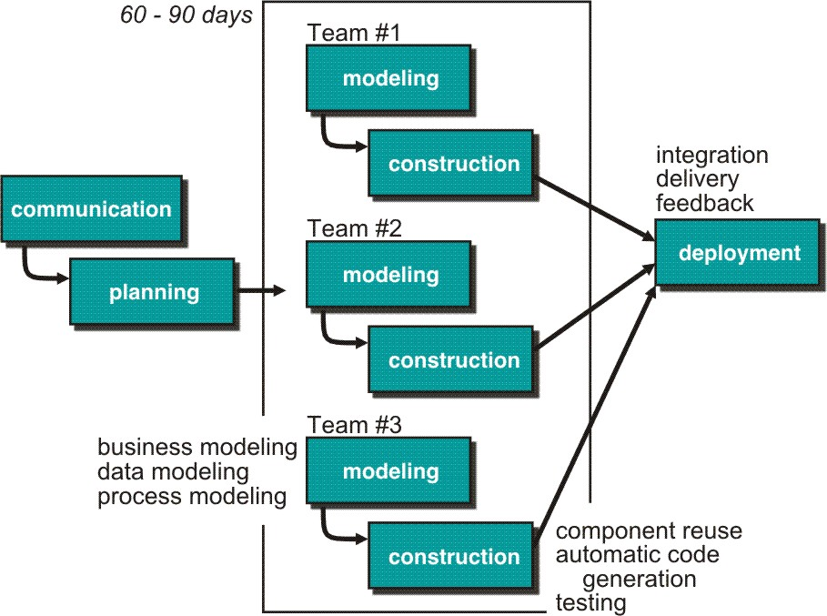
RAD model is like other process models map into the standard and major framework activities.

Slide 21
Phases Of RAD Model
Communication is an action which works to understand the business problem and the information characteristics that should be accommodated by the software.
In RAD model Planning is required because many software teams work in parallel on different system functions.
Modeling includes three major phases –
1.Business modeling2. Data modeling 3. Process modeling
Construction focuses mainly on the use of existing software components and the application of automatic code generation.
In the last stage, Deployment establishes a basis for subsequent iterations if necessary.

Slide 22
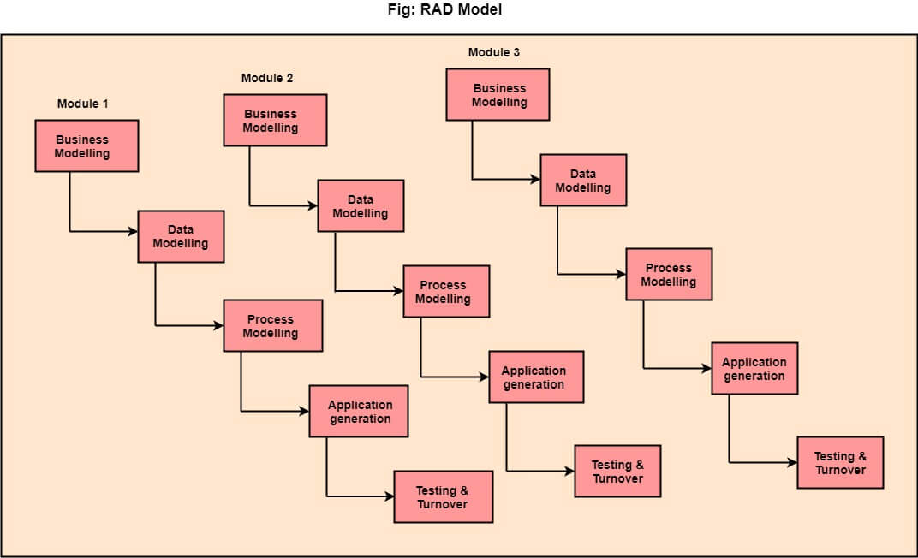

Slide 23
The various phases of RAD are as follows:
1. Business Modeling: In business modeling gather information from the customer and based on the information we divide the modules that means dividing various business modeling is called business modeling.
2. Data Modeling: Information gathered from business modeling we can process the data in data modeling.
3. Process Modeling: the process modeling the information is processed in data modeling the information to the customer; customer satisfaction go to the next level.
4. Application Generation: Automated tools are used to facilitate the construction of the software; even if they use the 4th GL techniques.
5. Testing & Turnover: Many of the programming components have already been tested since RAD emphasizes reuse. This reduces the overall testing time. However the new part must be tested, and all interfaces must be fully exercised.

Slide 24
When to use RAD Model?
When the system should need to create the project that modularizes in a short span time (2-3 months).
When the requirements are well-known.
When the technical risk is limited.
When there's a necessity to make a system, which modularized in 2-3 months of period.
It should be used only if the budget allows the use of automatic code generating tools.

Slide 25
Advantage of RAD Model
This model is flexible for change.
Each phase in RAD brings the highest priority functionality to the customer.
It reduced development time.
It increases the reusability of features.
Disadvantage of RAD Model
It required highly skilled designers.
For smaller projects, we cannot use the RAD model.
On the high technical risk, it's not suitable.
Required user involvement.

Slide 26
Unified process Model
The Unified Process (UP) is a software development framework used for object-oriented modeling. The framework is also known as Rational Unified Process (RUP) and the Open Unified Process (Open UP). Some of the key features of this process include:
It defines the order of phases.
It is component-based, meaning a software system is built as a set of software components. There must be well-defined interfaces between the components for smooth communication.
It follows an iterative, incremental, architecture-centric, and use-case driven approach.

Slide 27
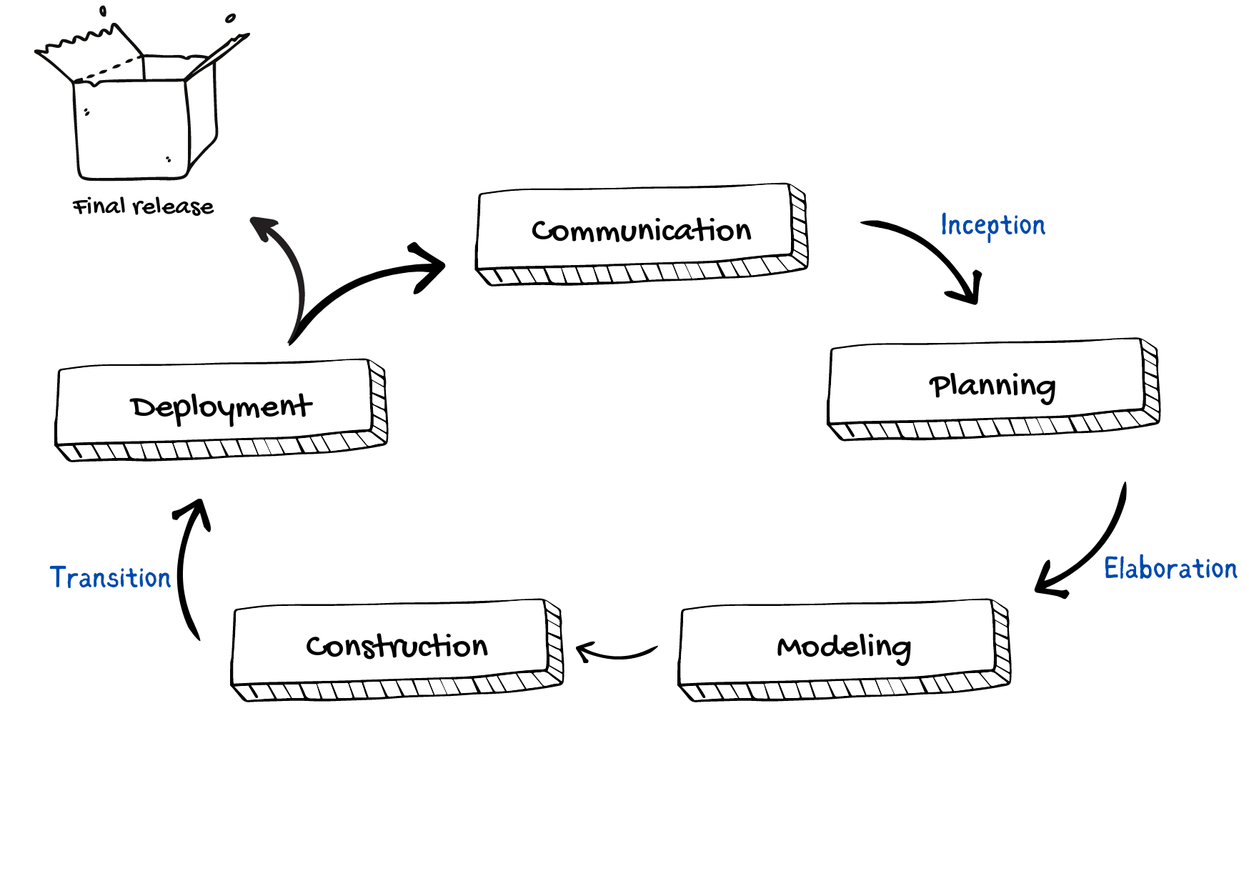
A visual representation of the unified process

Slide 28
Let's have a look at these approaches in detail.
The case-driven approach
Use a case-driven approach that follows a set of actions performed by one or more entities. A use case refers to the process of the team performing the development work from the functional requirements. The functional requirements are made from the list of requirements that the client specified. For example, an online learning management system can be specified in terms of use cases such as "add a course," "delete a course," "pay fees," and so on.
The architecture-centric approach
The architecture-centric approach defines the form of the system and how it should be structured to provide a specific functionality whereas the use case defines the functionality.
The iterative and incremental approach
An iterative and incremental approach means that the product will be developed in multiple phases. During these phases, the developers evaluate and test.

Slide 29
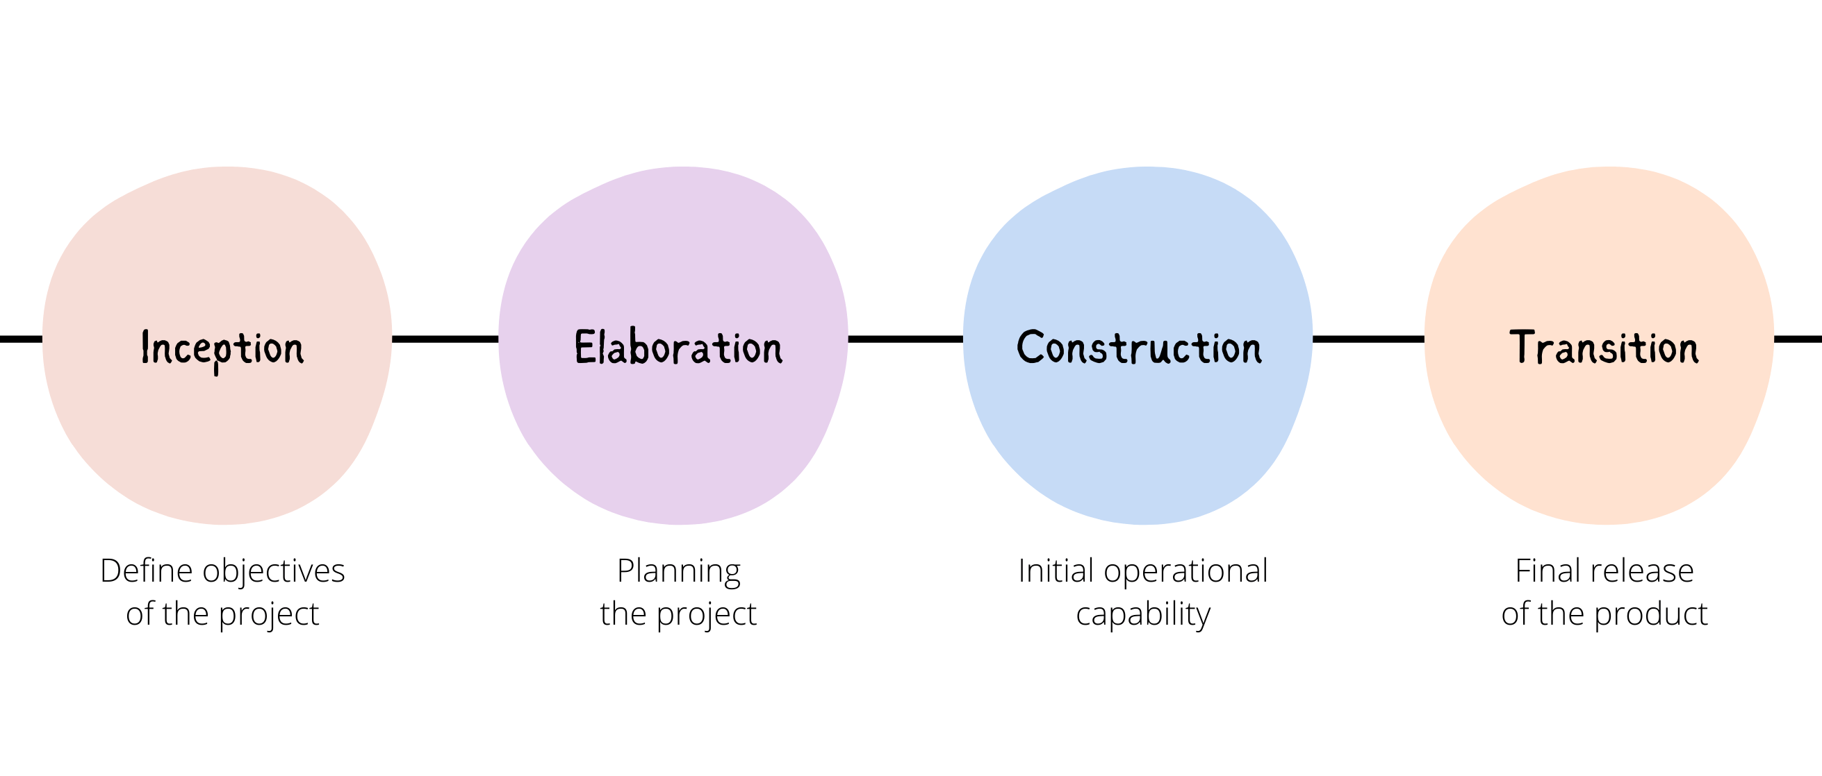
Phases
We can represent a unified process model as a series of cycles. Each cycle ends with the release of a new system version for the customers. We have four phases in every cycle:
Inception
Elaboration
Construction
Transition

Slide 30
Inception
The main goal of this phase involves delimiting the project scope. This is where we define why we are making this product in the first place. It should have the following:
What are the key features?
How does this benefit the customers?
Which methodology will we follow?
What are the risks involved in executing the project?
Schedule and cost estimates.
Elaboration
We build the system given the requirements, cost, and time constraints and all the risks involved. It should include the following:
Develop with the majority of the functional requirements implemented.
Finalize the methodology to be used.
Deal with the significant risks involved.

Slide 31
Construction
This phase is where the development, integration, and testing occur. We build the complete architecture in this phase and hand the final documentation to the client.
Transition
This phase involves the deployment, multiple iterations, beta releases, and software improvements. The users will test the software, which may raise potential issues. The development team will then fix those errors.

Slide 32
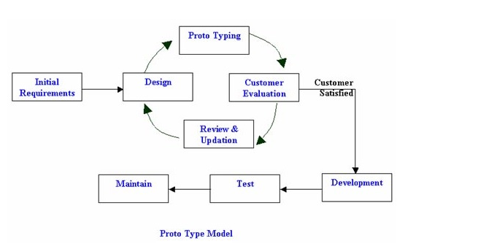
Evolutionary Process Models:
Prototyping Model:-

Slide 33
Initial Requirements
A prototyping model starts with requirement analysis. In this phase, the requirements of the system are defined in detail. During the process, the users of the system are interviewed to know what is their expectations from the system.
Design
The second phase is a preliminary design or a quick design. In this stage, a simple design of the system is created. However, it is not a complete design. It gives a brief idea of the system to the user. The quick design helps in developing the prototype.
Prototype
In this phase, an actual prototype is designed based on the information gathered from the design. It is a small working model of the required system.
User evaluation
In this stage, the proposed system is presented to the client for an initial evaluation. It helps to find out the strengths and weaknesses of the working model. Comments and suggestion are collected from the customer and provided to the developer.

Slide 34
Review & Updation
If the user is not happy with the current prototype, you need to refine the prototype according to the user’s feedback and suggestions.
Development
This phase will not be over until all the requirements specified by the user are met. Once the user is satisfied with the developed prototype, a final system is developed based on the approved final prototype.
Implement Product and Maintain
Once the final system is developed based on the final prototype, it is thoroughly tested and deployed to production. The system undergoes routine maintenance to minimize downtime and prevent large-scale failures.

Slide 35
When to use Prototyping Model?
1. Long or Big Project.
2. Requirements are not clear when we choose.
Advantages:-
Customer can see study progress.
This is useful when requirements are changing rapidly
Disadvantages:-
It is impossible to know how long it will take.
There is no way to know the no. of iterations will be required

Slide 36
Spiral Model
Spiral Model is a risk-driven software development process model. It is a combination of the waterfall model and the iterative model.
Spiral Model helps to adopt software development elements of multiple process models for the software project based on unique risk
Patterns ensuring efficient development process.
Each phase of the spiral model in software engineering begins with a design goal and ends with the client reviewing the progress.
The development process in the Spiral model in SDLC, starts with a small set of requirements and goes through each development phase for those set of requirements. The software engineering team adds functionality for the additional requirement in every-increasing spirals until the application is ready for the production phase.

Slide 37
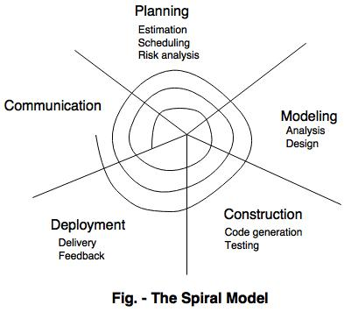
The below figure very well explains Spiral Model:

Slide 38
Concept development is the initial stage of software development, where you identify if there is a market for your product, study your target audience problems, build your value proposition, and prepare materials for testing it on your potential customers
Systems development is the process of defining, designing, testing, and implementing a new software application or program. It could include the internal development of customized systems, the creation of database systems, or the acquisition of third party developed software
System enhancement is any product change or upgrade that increases software or hardware capabilities beyond original client specifications. Enhancements allow software and hardware product performance scalability.
System maintenance phase, the customer monitors the software to ensure it continues to operate according to the coding specifications. In addition to monitoring software functionality, the customer also repairs defects and upgrades software when necessary

Slide 39
When to use Spiral Model?
A Spiral model in software engineering is used when project is large
When releases are required to be frequent, spiral methodology is used
When risk and costs evaluation is important
Spiral methodology is useful for medium to high-risk projects
When requirements are unclear and complex, Spiral model in SDLC is useful
When changes may require at any time

Slide 40
Advantages-
Fast development
Development of all phases is carried out in a controlled manner
Customer feedback is taken into account for the modifications to be done accordingly in case required
Suitable for large projects
Suitable for risky projects
Continuous risk analysis helps in better development
Useful in rapidly changing requirements
Disadvantages-
Not suitable for smaller projects because of the high cost associated with the development process
High possibility of not meeting the set budget or time limit.

Slide 41
concurrent development model
The concurrent development model is called as concurrent model.
The communication activity has been completed in the first iteration and exits in the awaiting changes state.
The modeling activity completed its initial communication and then go to the underdevelopment state.
If the customer specifies the change in the requirement, then the modeling activity moves from the under-development state into the awaiting change state.
The concurrent process model activities moving from one state to another state.

Slide 42
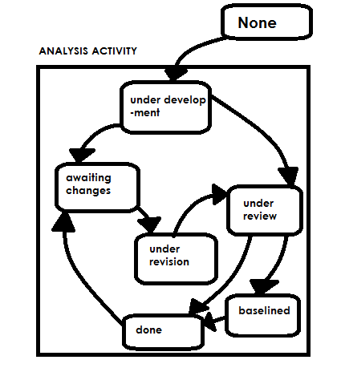

Slide 43
Advantages of the concurrent development model
This model applies to all types of software development processes.
It is easy to understand and use.
It gives immediate feedback from testing.
It provides an accurate picture of the current state of a project.
Disadvantages of the concurrent development model
It needs better communication between the team members. This may not be achieved all the time.
It requires to remember the status of the different activities.

Slide 44
V-Model
V-Model is also referred to as the Verification and Validation Model. In this, each phase of SDLC must be completed before the next phase starts. It follows a sequential design process same as the waterfall model. Testing of the device is planned in parallel with a corresponding stage of development.

Slide 45
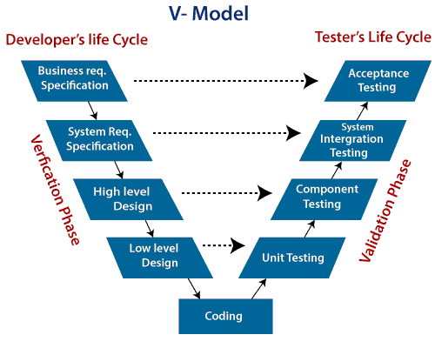

Slide 46
Verification: It involves a static analysis method (review) done without executing code. It is the process of evaluation of the product development process to find whether specified requirements are met.
Validation: It involves a dynamic analysis method (functional, non-functional), testing is done by executing code. Validation is the process of classifying the software after the completion of the development process to determine whether the software meets the customer’s expectations and requirements.

Slide 47
So V-Model contains Verification phases on one side of the Validation phases on the other side. Verification and Validation process is joined by coding phase in V-shape. Thus it is known as V-Model.
There are the various phases of Verification Phase of V-model:
1. Business requirement analysis: This is the first step where product requirements understood from the customer's side. This phase contains detailed communication to understand customer's expectations and exact requirements.
2. System Design: In this stage system engineers analyze and interpret the business of the proposed system by studying the user requirements document.

Slide 48
3. Architecture Design: The baseline in selecting the architecture is that it should understand all which typically consists of the list of modules, brief functionality of each module, their interface relationships, dependencies, database tables, architecture diagrams, technology detail, etc. The integration testing model is carried out in a particular phase.
4. Module Design: In the module design phase, the system breaks down into small modules. The detailed design of the modules is specified, which is known as Low-Level Design
5. Coding Phase: After designing, the coding phase is started. Based on the requirements, a suitable programming language is decided. There are some guidelines and standards for coding. Before checking in the repository, the final build is optimized for better performance, and the code goes through many code reviews to check the performance.

Slide 49
There are the various phases of Validation Phase of V-model:
1. Unit Testing: In the V-Model, Unit Test Plans (UTPs) are developed during the module design phase. These UTPs are executed to eliminate errors at the code level or unit level. A unit is the smallest entity that can independently exist, e.g., a program module. Unit testing verifies that the smallest entity can function correctly when isolated from the rest of the codes/ units.
2. Integration Testing: Integration Test Plans are developed during the Architectural Design Phase. These tests verify that groups created and tested independently can coexist and communicate among themselves.

Slide 50
3. System Testing: System Tests Plans are developed during System Design Phase. Unlike Unit and Integration Test Plans, System Tests Plans are composed by the client?s business team. System Test ensures that expectations from an application developer are met.
4. Acceptance Testing: Acceptance testing is related to the business requirement analysis part. It includes testing the software product in user atmosphere. Acceptance tests reveal the compatibility problems with the different systems, which is available within the user atmosphere. It conjointly discovers the non-functional problems like load and performance defects within the real user atmosphere.
When to use V-Model?
When the requirement is well defined and not ambiguous.
The V-shaped model should be used for small to medium-sized projects where requirements are clearly defined and fixed.
The V-shaped model should be chosen when sample technical resources are available with essential technical expertise.

Slide 51
Advantage (Pros) of V-Model:
Easy to Understand.
Testing Methods like planning, test designing happens well before coding.
This saves a lot of time. Hence a higher chance of success over the waterfall model.
Avoids the downward flow of the defects.
Works well for small plans where requirements are easily understood.
Disadvantage (Cons) of V-Model:
Very rigid and least flexible.
Not a good for a complex project.
Software is developed during the implementation stage, so no early prototypes of the software are produced.
If any changes happen in the midway, then the test documents along with the required documents, has to be updated.

Slide 52
Agile Model
The meaning of Agile is swift or versatile. “Agile process model" refers to a software development approach based on iterative development. Agile methods break tasks into smaller iterations, or parts that do not directly involve long-term planning. The project scope and requirements are laid down at the beginning of the development process. Plans regarding the number of iterations, the duration, and the scope of each iteration are clearly defined in advance.
Each iteration is considered as a short time "frame" in the Agile process model, which typically lasts from one to four weeks. The division of the entire project into smaller parts helps to minimize the project risk and to reduce the overall project delivery time requirements. Each iteration involves a team working through a full software development life cycle including planning, requirements analysis, design, coding, and testing before a working product is demonstrated to the client.

Slide 53
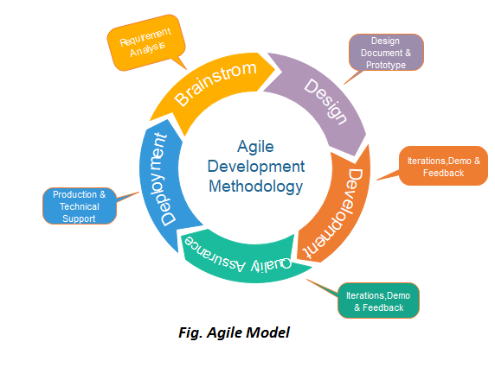

Slide 54
Phases of Agile Model:
Following are the phases in the Agile model are as follows:
1. Requirements gathering
2. Design the requirements
3. Construction/ iteration
4. Testing/ Quality assurance
5. Deployment
6. Feedback

Slide 55
1. Requirements gathering: In this phase, you must define the requirements. You should explain business opportunities and plan the time and effort needed to build the project. Based on this information, you can evaluate technical and economic feasibility.
2. Design the requirements: When you have identified the project, work with stakeholders to define requirements. You can use the user flow diagram or the high-level UML diagram to show the work of new features and show how it will apply to your existing system.
3. Construction/ iteration: When the team defines the requirements, the work begins. Designers and developers start working on their project, which aims to deploy a working product. The product will undergo various stages of improvement, so it includes simple, minimal functionality.

Slide 56
4. Testing: In this phase, the Quality Assurance team examines the product's performance and looks for the bug.
5. Deployment: In this phase, the team issues a product for the user's work environment.
6. Feedback: After releasing the product, the last step is feedback. In this, the team receives feedback about the product and works through the feedback.
Agile Testing Methods:
Scrum
Crystal
Dynamic Software Development Method(DSDM)
Feature Driven Development(FDD)
Lean Software Development
eXtreme Programming(XP)

Slide 57
When to use the Agile Model?
When frequent changes are required.
When a highly qualified and experienced team is available.
When a customer is ready to have a meeting with a software team all the time.
When the project size is small.
Advantage(Pros) of Agile Method:
Frequent Delivery
Face-to-face communication with clients.
Efficient design and fulfils business requirements.
Anytime changes are acceptable.
It reduces total development time.
Disadvantages(Cons) of Agile Model:
Due to the shortage of formal documents, it creates confusion and crucial decisions taken throughout various phases can be misinterpreted at any time by different team members.
Due to the lack of proper documentation, once the project is completed and the developers are allotted to another project, maintenance of the finished project can become a difficulty.

